Slide 1






Hello SQL
SELECT *
FROM instructors
WHERE name = Darie Dorlus
AND title NOT LIKE “Head SQL Ninja”
darie@bocacode.com

Slide 2
Pop Quiz?
What does SQL Stand for?

Slide 3
SEQUEL: IBM’s Idea of a Joke

Slide 4
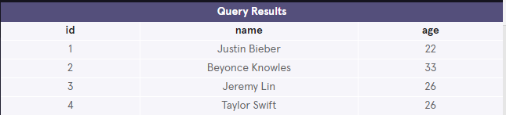
A Table
a collection of data organized into rows and columns.

Slide 5
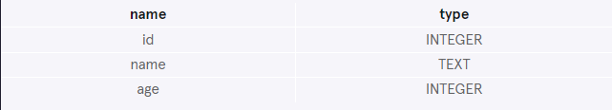
A Column
is a set of data values of a particular type. Here, id, name, and age are the columns.

Slide 6
A Row
a single record in a table.

Slide 7
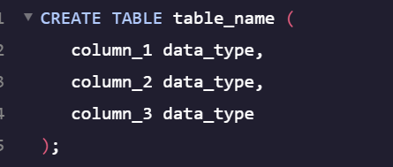
Creating a Table

Slide 8
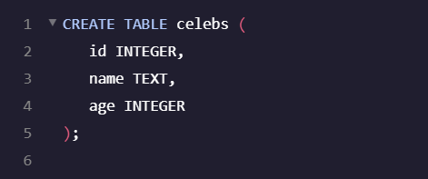
Creating a Table

Slide 9

Inserting Data

Slide 10
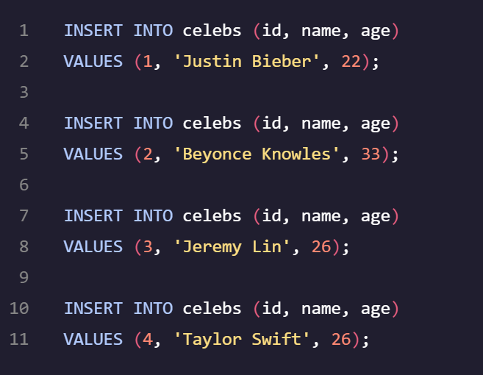
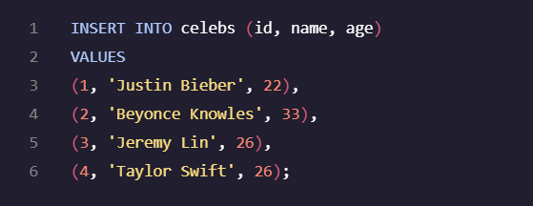
Inserting Data

Slide 11
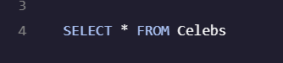
Retrieving/Fetching Data

Slide 12

Fetching Some Data

Slide 13
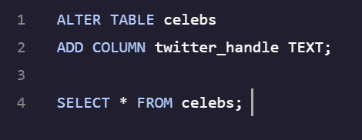
Altering Table

Slide 14
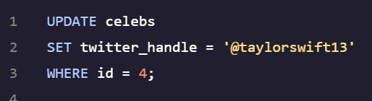
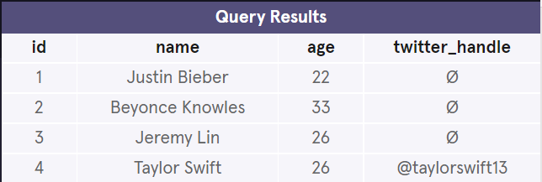
Updating Data

Slide 15
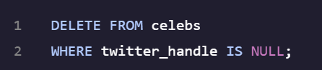
Deleting Data

Slide 16
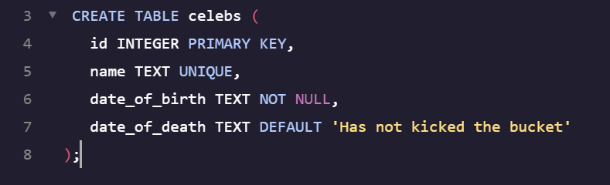
Constraints
Specify how columns can be used

Slide 17
Querying

Slide 18
Constraints
Specify how columns can be used

Slide 19
The WHERE Clause

Slide 20
Thank You.

